Slide 1
MLMQ Mat Luke Message Queuing
Advanced Systems Lab – Milestone 1
Matthias Ganz & Lukas Elmer
HS 13/14
ETHZ

Slide 2


Slide 3
Agenda
Design
Experiments
Lessons Learned about the System

Slide 4

Design

Slide 5
Design – Overview
Client
Client
Client
Middleware
Database
Client
Client
Client
TCP IP Sockets
Middleware
JDBC
Client
Client
Client
Middleware

Slide 6
Design – Middleware
Middleware
Request Queue
NIO
DB Connection Pool
Client
Database
Client
Client
Client
Client
Worker
Response Queue
Buffer Pool
Notes:
NIO: Expensive:
Create network connections
Pools: Expensive:
Create threads
Establish DB connections
Create objects
Queues: concurrent, workers work independently

Slide 7
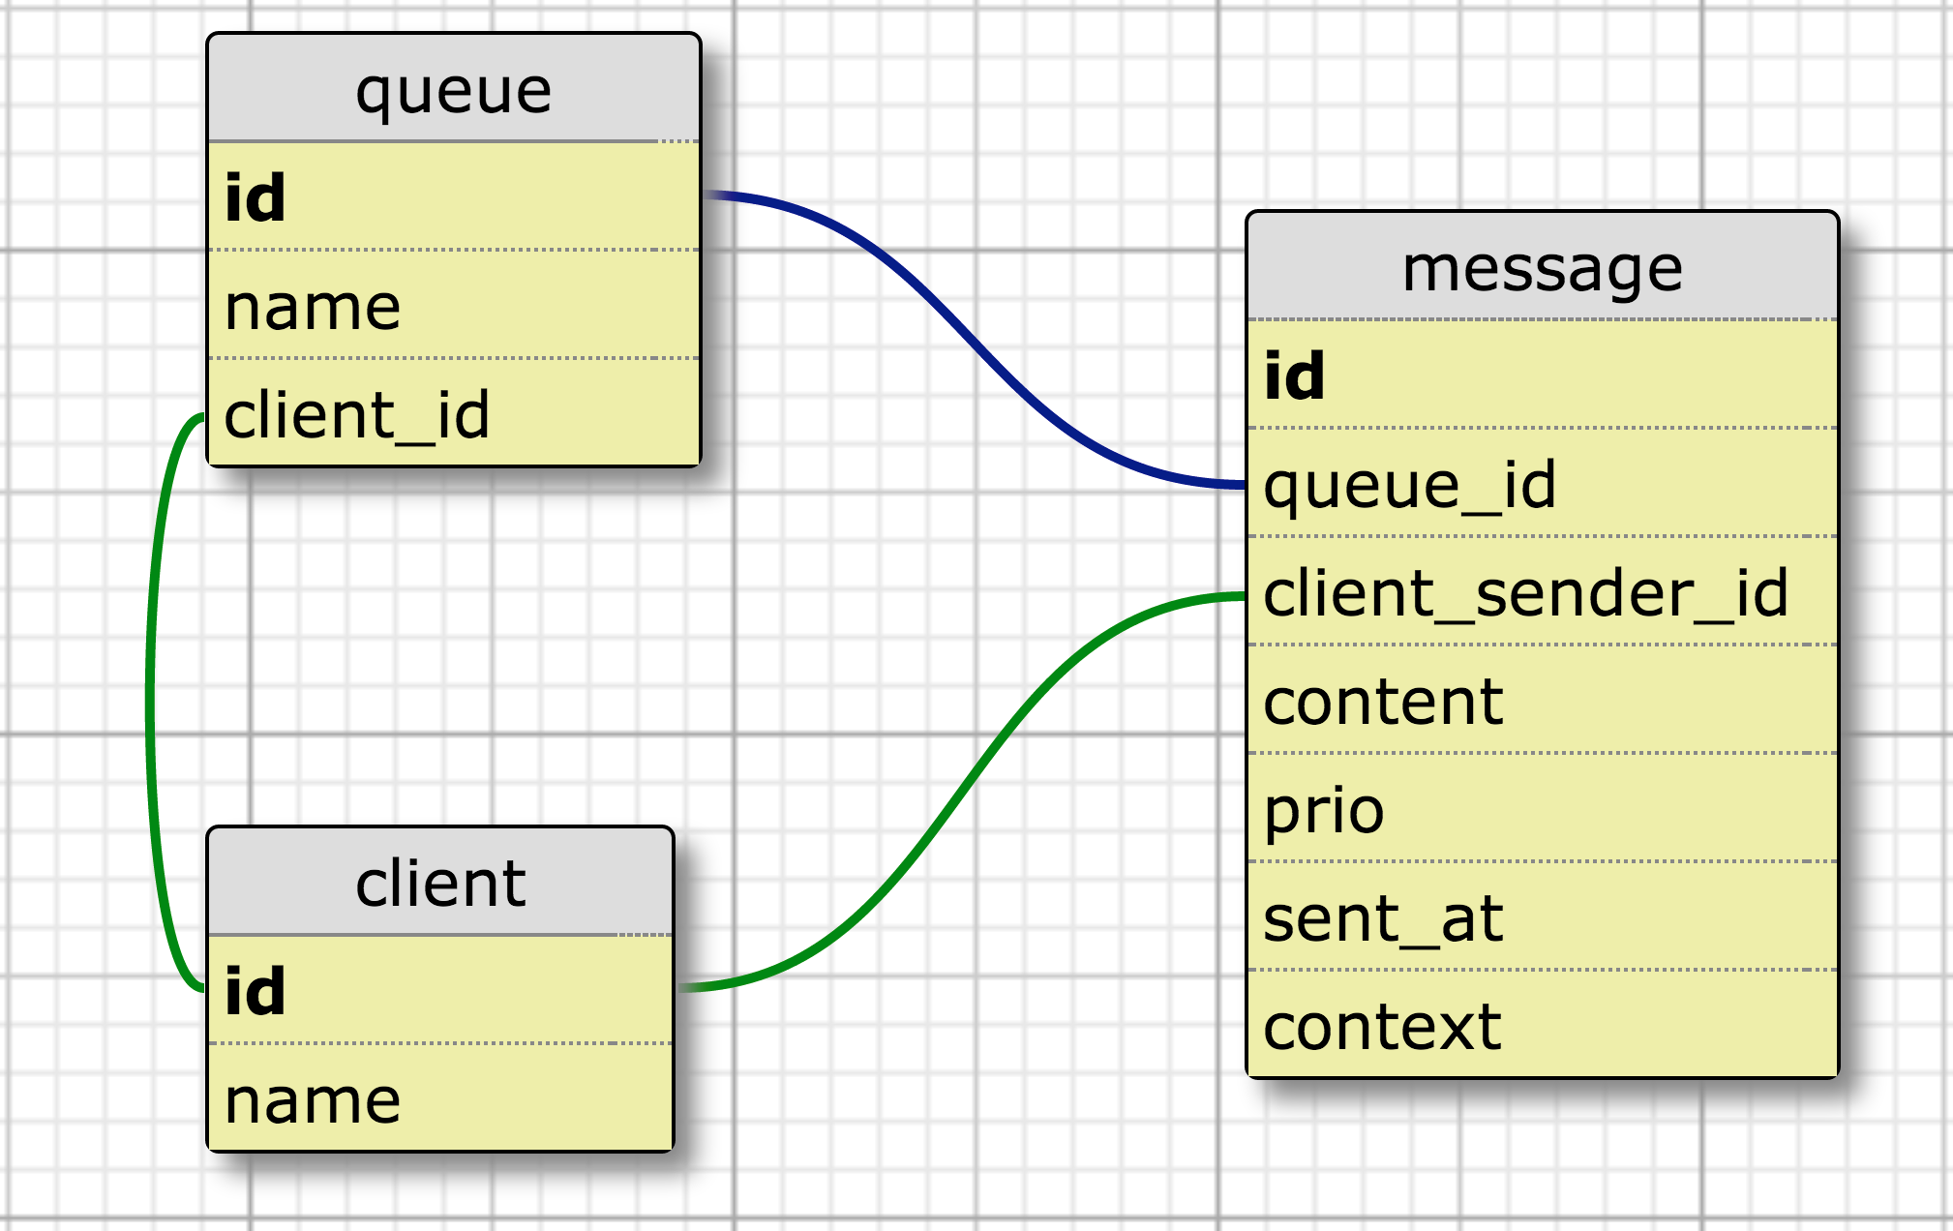
Design – Database
Notes:
KISS
Context: For request – response
Otherwise would use two fields is_request_response and message_id
No receiver_id: Every client owns a private queue

Slide 8
Design – Database Interface
Indices
Queue: client_id
Client: name
Message: queue_id, prio, sent_at, client_sender_id, context
Important stored procedures
peekMessage
dequeueMessage
Locks a specific record for dequeuing
Prepared statements & auto commit

Slide 9
Design – Client Interface
ClientDto register()
ClientDto lookupClient(String clientName)
QueueDto lookupClientQueue(long clientId)
QueueDto createQueue(String queueName)
QueueDto lookupClientQueue(String queueName)
void deleteQueue(long id)
void sendMessage(long queueId, byte[] content, int prio)
void sendMessage(long[] queueIds, byte[] content, int prio)
void sendMessageToClient(long clientId, byte[] content, int prio)
long sendRequestToClient(long client, byte[] content, int prio)
long sendResponseToClient(long clientId, long context, byte[] content, int prio)
int queuesWithPendingMessages(List<QueueDto> queues, int maxNumQueues)
MessageDto peekMessage(MessageQueryInfoDto messageQueryInfo)
MessageDto dequeueMessage(MessageQueryInfoDto messageQueryInfo)

Slide 10

Experiments

Slide 11
Experiments – Summary
Stability
2h Test
Best configuration
Throughput vs. response time
2^{k} Test
Bottlenecks, optimization Points
Which component spends how much time
System limit
Load tests

Slide 12
Experiments – Setup
Client
Client
Client
Middleware
Database
Client
Client
Client
Middleware
Client
Client
Client
Middleware
?
Config

Slide 13


Experiments – Setup
Client
Client
Client
Middleware
Database
Client
Client
Client
Middleware
Client
Client
Client
Middleware
Config
Testmaster
Notes:
Ruby

Slide 14
Experiments – Setup
Client
Client
Client
Middleware
Database
Client
Client
Client
Middleware
Client
Client
Client
Middleware
Testmaster
Logs

Slide 15
Experiments – Setup
Client
Client
Client
Middleware
Database
Client
Client
Client
Middleware
Client
Client
Client
Middleware
Testmaster
Logs
Plots & Statistics

Slide 16
Experiments – Sequential Test
C
C
C
M
DB
C
C
C
M
C
C
C
M
Testmaster

Slide 17
Experiments – Parallel Tests
C
C
C
C
C
C
C
M
C
M
C
M
DB
DB
DB
C
C
C
C
C
C
C
M
C
M
C
M
C
C
C
C
C
C
C
M
C
M
C
M
Testmaster 1
Testmaster 2
Testmaster 2
Cannot to 20 Amazon EC2 instances Request to Increase Amazon EC2 Instance Limit

Slide 18
Experiments – 2h Test without warmup / cooldown time, response time
Notes:
Balken aufgelöst ca. 1 min
Konfidenzintervall
Balken Throughput und response time
Evt. Mit 2 => mit/ohne Abschneiden

Slide 19
Experiments – 2h Test with 4 minutes warmup / cooldown time, response time
Notes:
Balken aufgelöst ca. 1 min
Konfidenzintervall
Balken Throughput und response time
Evt. Mit 2 => mit/ohne Abschneiden

Slide 20
Experiments – 2h Test without warmup / cooldown time, throughput
Notes:
We turned off one middleware after 90 minutes.
Balken aufgelöst ca. 1 min
Konfidenzintervall
Balken Throughput und response time
Evt. Mit 2 => mit/ohne Abschneiden

Slide 21
Experiments – 2h Test with 4 minutes warmup / cooldown time, throughput
Notes:
We turned off one middleware after 90 minutes.
Balken aufgelöst ca. 1 min
Konfidenzintervall
Balken Throughput und response time
Evt. Mit 2 => mit/ohne Abschneiden

Slide 22
Experiments – 2h Test
For the 2h Test configuration
For 95% of all sendMessage requests, the response time will be under 50 ms
For 95% of all dequeueMessage requests, the response time will be under 62 ms
Notes:
Diagramm in the report

Slide 23
Experiments – Results, 2h Test
Notes:
TODO: insert real one:
CSndReq#OK#SendMessageRequest,CSndReq#OK#DequeueMessageRequest,BProcReq#SendMessageRequest,BProcReq#DequeueMessageRequest,BDb#insertMessage,BDb#dequeueMessage#Ok

Slide 24
Experiments – Results, 2h Test

Slide 25
Experiments – Results, 2h Test

Slide 26
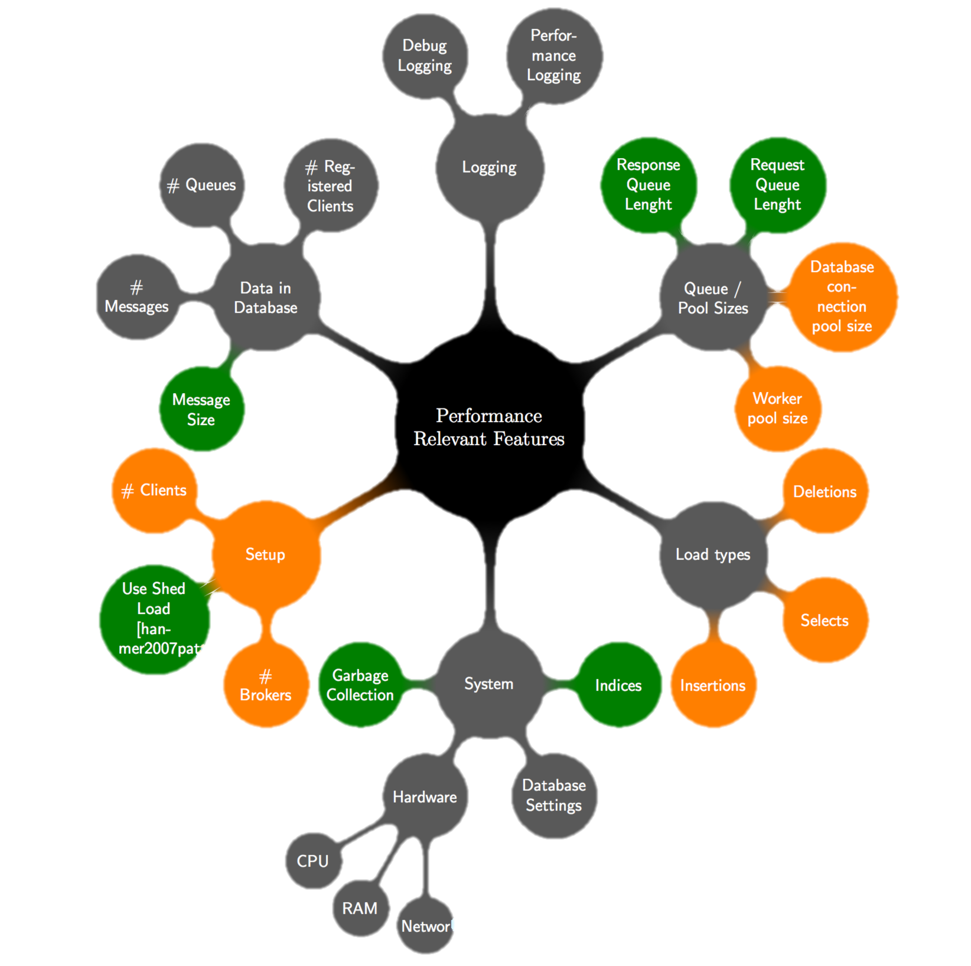
Experiments – Factors

Slide 27
Experiments – Primary Factors
# Clients
# Brokers
DB Connection Pool Size
Worker Pool Size
2^{k} Test

Slide 28
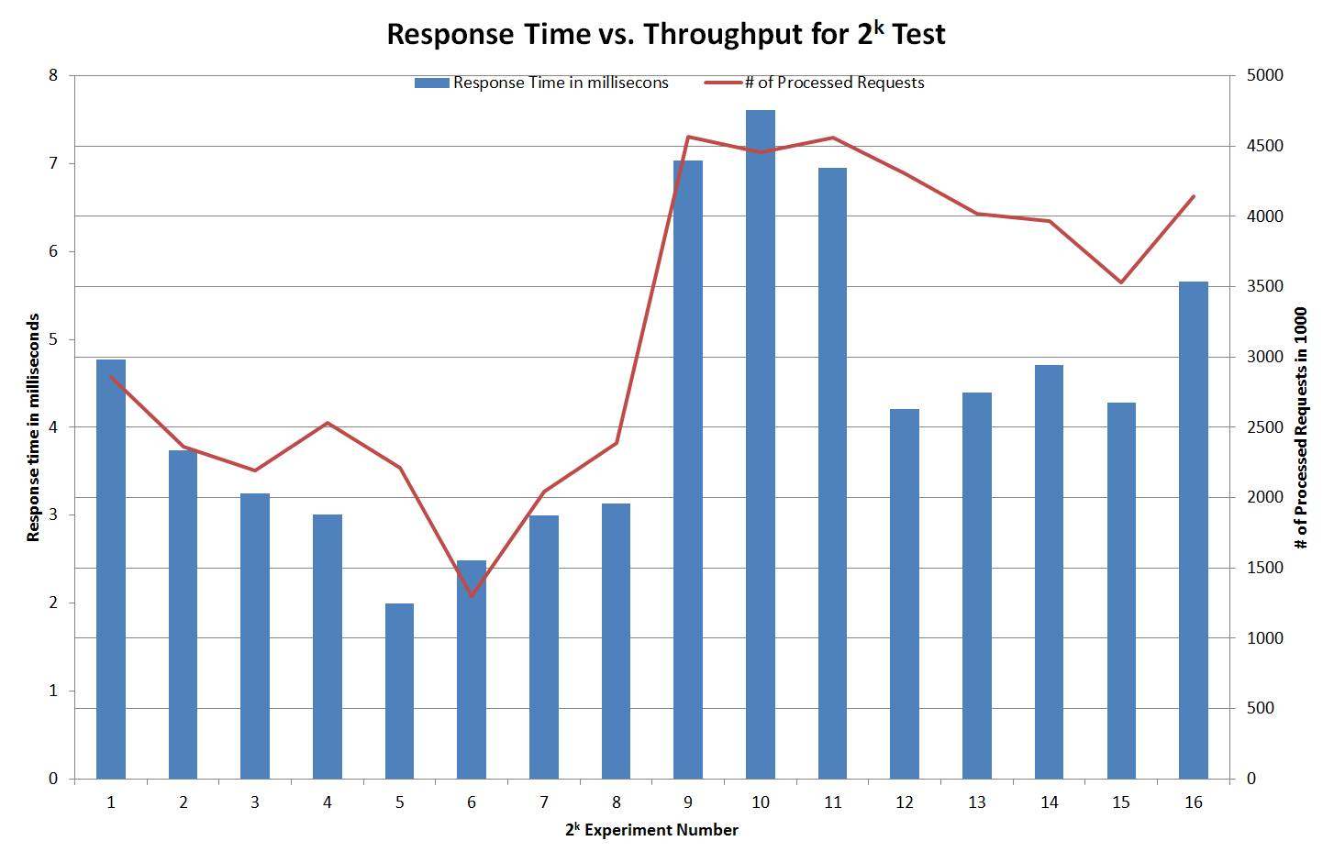
Experiments – Results: 2^{k} Test

Slide 29
Experiments – Results: 2^{k} Test
Interpretation
Higher throughput ➔ higher response time

Slide 30
Experiments – Incremental Load Test, Response Time

Slide 31
Experiments – Incremental Load Test, Response Time
Interpretation: Higher load ➔
Slower database
Higher database response time variance

Slide 32
Experiments – Incremental Load Test, Response Time
underload
saturated
trashing

Slide 33
Experiments – Incremental Load Test, Throughput
underload
saturated
trashing?
# of Successful Requests in 1000

Slide 34

Lessons Learned about the System

Slide 35
Lessons Learned about the System
Improvements during this milestone
Response time stability
Throughput
Saturated system
=> higher throughput
=> higher variance in response time
Potential bottleneck
Database

Slide 36
Questions
Thank you

